Slide 1
بسم الله الرحمن الرحيم

Slide 2


People’s Democratic Republic of Algeria
Ministry of Higher Education and Scientific Research
University of Abdelhamid Mehri – Constantine 2
Faculty of New Technologies of Information and Communication (NTIC)
Department of Fundamental Computing and its Applications (IFA)
A Microservices-based Information Platform for Monitoring Projects Development: Higher Education Sector Application Domain
Graduation Project For Obtaining the Master's Degree in Computer Science
Presented by:
Under Supervision of:
Benarab Islem
Boubiasli Mohamed Chaouki
Pr. Chaoui Allaoua
Dr. Meghzili Said

Slide 3
Presentation plan

Slide 4


PRESENTATION PLAN
01
Introduction
05
Development Process and System Design
02
Project management
PLAN
06
Microservices overview
03
Project Management life-cycle
07
System Implementation
04
Public Procurement Process
08
Conclusion and Perspectives

Slide 5
Introduction

Slide 6


1
Project Background
INTRODUCTION
2
Application Domain
3
Problem
4
Proposed Solutions

Slide 7




Project Background
Project management drives business success and stakeholders satisfaction.
It aims to meet requirements and improve operations.
It ensures the timely completion of projects, adherence to budget constraints.

Slide 8




Application Domain:
The Higher education Sector which has:
Various Stakeholders including Authority Responsibles.
Intricate Processes and laws.
Confidential Documents.

Slide 9



Problem Statement
Old-fashioned paper-based approaches, are:
Time-consuming, leading to delays
and inefficiencies.
Prone to errors due to manual data entry.
Burdened with tedious tasks.

Slide 10





Proposed Solutions
A microservices-based application as a solution that offers stakeholders:
Easy navigation, access to project information, and streamlined demand submission
Empowering stakeholders to edit, track progress
Task monitoring, and access to insightful statistics.

Slide 11
Project Management

Slide 12



Project Management is a set of:
01
02
03
Knowledge
Skills
Tools

Slide 13










Project Management Life cycle
Project starting phase, defining objectives and stakeholders.
Implementation of project tasks, managing scope and team coordination.
Finalizing deliverables, project review, and formal completion.
Planning
Monitoring
Execution
Closure
Initiation
Detailed project plan creation, resource estimation, and risk assessment.
Ongoing tracking and assessment of project progress, ensuring that tasks are being completed as planned
13

Slide 14
Public Procurement Process
Needs Identification
Goods Delivery
01
06
Public Procurement
Process
Request Submitting
02
05
Purchase Order Creation
03
04
Supplier Selection
Price and Terms Negotiation
14

Slide 15
Development Process and System Design

Slide 16

The Simplified Development Process
UML(Unified Modeling Language) Diagrams: Visual representations of system structure, behavior, and interactions.
UP (Unified Process) : is an iterative and incremental approach to software development
To Identify our system needs and create the use case diagrams we pursued the Information-gathering methodology that includes: documents reviews and interviews at the vice-rectorate of the university of constantine2

Slide 17
The Development Process Workflow
Implementation
State Machine Diagrams
Class Diagrams
System Sequence Diagrams
Use-Case Diagrams

Slide 18
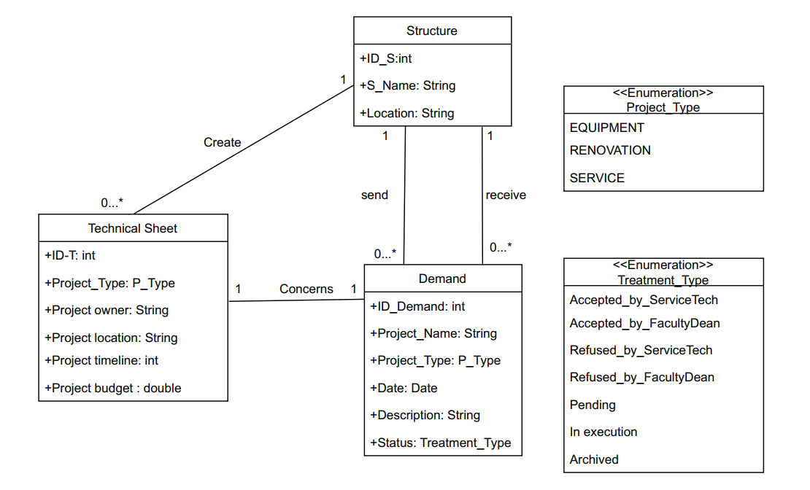
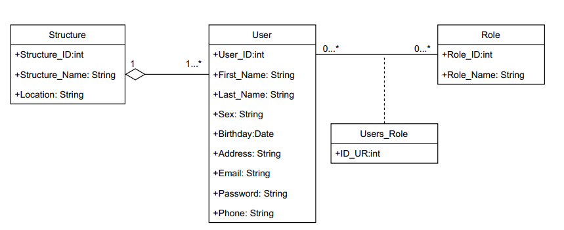
Microservices-based Design Approach
Each microservice has a Specific Use-case and a Class diagram to show the decomposition of the microservices-based architecture following Domain-Driven Design Approach
Examples of some Class Diagrams:
Class Diagram for Accounts Microservice
Class Diagram for Demand Microservice

Slide 19
Microservices
Overview

Slide 20



Microservices
Microservices are small, independent services that work together to form a larger application, allowing for flexibility, scalability, and easier maintenance.
There are two types of microservices:
Fine-grained microservices: Small, specialized services that are responsible for specific and narrowly defined
Coarse-grained microservices: Larger, more comprehensive services that encapsulate multiple functionalities

Slide 21








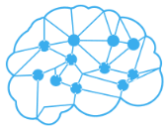



Microservices Characteristics
Resiliency and Fault tolerance
Security
Easy Deployment
Modularity and Independence
Scalability
Technology Diversity

Slide 22
Monolithic VS SOA VS MSA
Features | Monolithic | SOA | MSA
Modularity | Tightly coupled | closely connected | Independent services
Scalability | Scaling the whole app | Individual services | Individual services
Fault Isolation | System-wide failures | Limited impact | Limited impact
DataBase | One Shared DB | One Shared DB | DB for each MS
Deployment | Single unit deployment | Independent services | Independent services

Slide 23
System Implementation

Slide 24







Used Tools
ZipKin Server

Slide 25
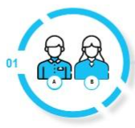
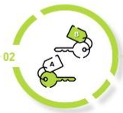
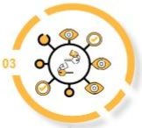
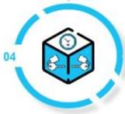
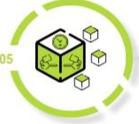

Execution Workflow
01
02
Routing Request to Relevant Microservice
03
User Interaction with Frontend
Token Verification at API Gateway
Request Processing and Data Retrieval
Response Handling via API Gateway
04
05
06
Token Authentication in Microservice
25

Slide 26
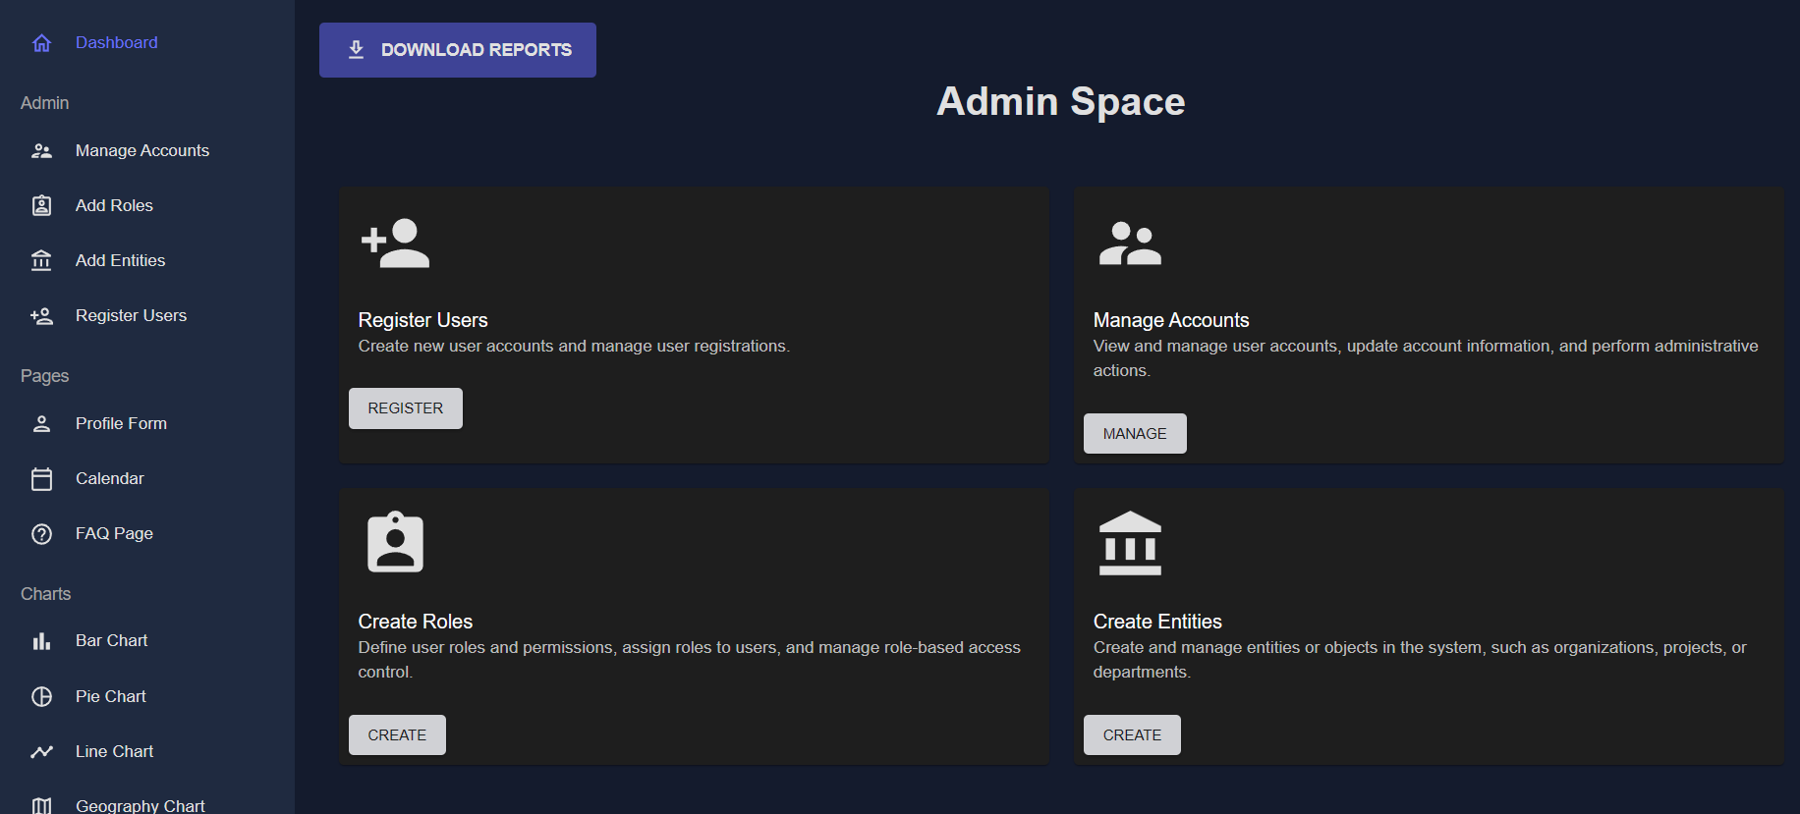
App Interfaces
Admin Dashboard
26

Slide 27
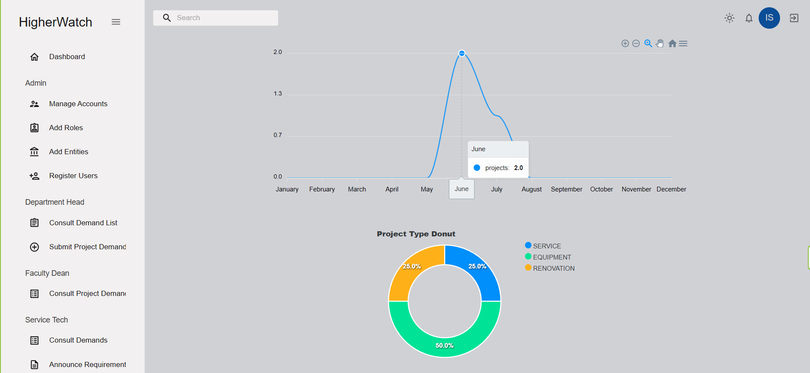
App Interfaces
Projects Statistics
27

Slide 28
Conclusion and Prespectives

Slide 29

Conclusion
The Microservices-based Approach facilitates project management by:
Enabling modular, scalable, and flexible development
Enhancing collaboration among teams.
Promoting independent deployment
and fault isolation

Slide 30

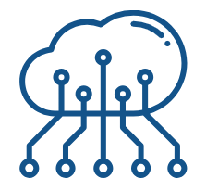



Perspectives
The future work perspective involves:
Extend app to include additional domains of operation.
Enhance functionality and incorporate advanced statistical analysis.
Integrate artificial intelligence to enable
intelligent decision-making.
Develop a mobile application for seamless access and user convenience.

Slide 31
Thank You
for your attention
Notes:
Limitations: manque de documentation, et de syntaxe, prblm de l’incompatibilité, éditeur non intelig, ne traite pas les erreur

